Slide 1
Unsupervised Learning: Deep Auto-encoder
Notes:
http://www.deeplearningbook.org/contents/autoencoders.html
Output
- idea of compressions
-audoencoder
- application
retrieval
image
-also as initilization

Slide 2
Unsupervised Learning
“We expect unsupervised learning to become far more important in the longer term. Human and animal learning is largely unsupervised: we discover the structure of the world by observing it, not by being told the name of every object.” – LeCun, Bengio, Hinton, Nature 2015
As I've said in previous statements: most of human and animal learning is unsupervised learning. If intelligence was a cake, unsupervised learning would be the cake, supervised learning would be the icing on the cake, and reinforcement learning would be the cherry on the cake. We know how to make the icing and the cherry, but we don't know how to make the cake.
- Yann LeCun, March 14, 2016 (Facebook)
Notes:
櫻桃梗

Slide 3
PCA

Slide 4
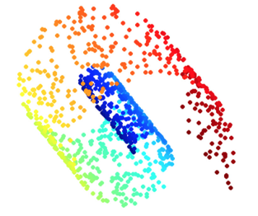
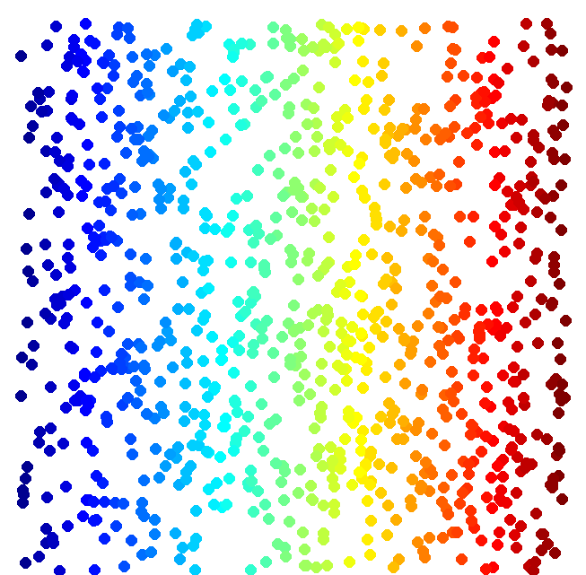
Dimension Reduction
function
vector x
vector z
(High Dim)
(Low Dim)
Looks like 3-D
Actually, 2-D
Notes:
http://reuter.mit.edu/blue/images/research/manifold.png
http://archive.cnx.org/resources/51a9b2052ae167db310fda5600b89badea85eae5/isomapCNXtrue1.png

Slide 5

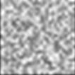
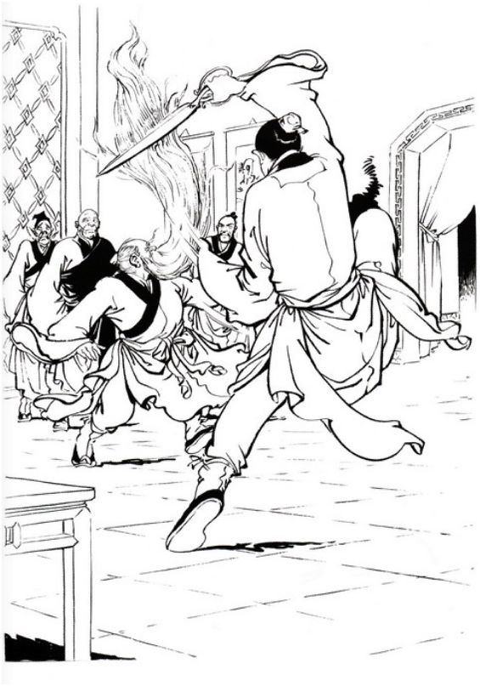
Dimension Reduction
In MNIST, a digit is 28 x 28 dims.
Most 28 x 28 dim vectors are not digits
3
3
3
3
3
-20。
-10。
0。
10。
20。
Notes:
用這個例子http://newsletter.sinica.edu.tw/file/file/4/485.pdf

Slide 6
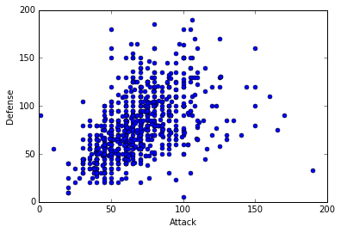


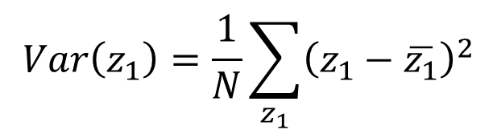


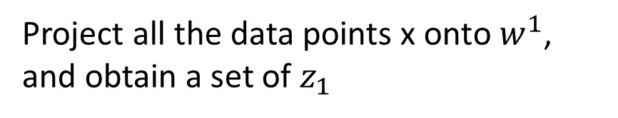



PCA
$$z=Wx$$
Large variance
Reduce to 1-D:
$$z_{1}=w^{1}∙x$$
Small variance
$$x$$
Project all the data points x onto $w^{1}$, and obtain a set of $z_{1}$
$$w^{1}$$
We want the variance of $z_{1}$ as large as possible
$$Var\left(z_{1}\right)=\frac{1}{N}\sum_{z_{1}}{{\left(z_{1}−\overline{z_{1}}\right)}^{2}}$$
$$z_{1}=w^{1}∙x$$
$${\left\|w^{1}\right\|}_{2}=1$$

Slide 7
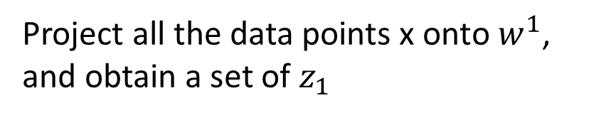
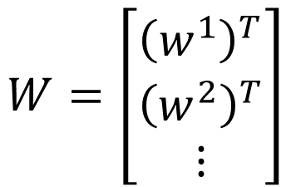
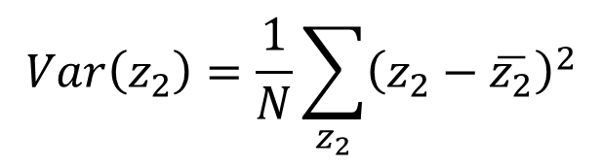




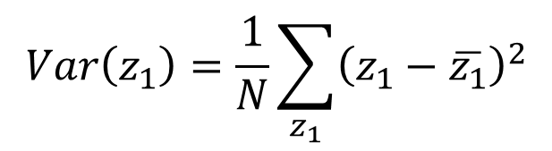


PCA
Project all the data points x onto $w^{1}$, and obtain a set of $z_{1}$
We want the variance of $z_{1}$ as large as possible
$$z=Wx$$
Reduce to 1-D:
$$Var\left(z_{1}\right)=\frac{1}{N}\sum_{z_{1}}{{\left(z_{1}−\overline{z_{1}}\right)}^{2}}$$
$${\left\|w^{1}\right\|}_{2}=1$$
$$z_{1}=w^{1}∙x$$
$$z_{2}=w^{2}∙x$$
We want the variance of $z_{2}$ as large as possible
$$W=\left[\begin{aligned}{\left(w^{1}\right)}^{T} \\ {\left(w^{2}\right)}^{T} \\ ⋮\end{aligned}\right]$$
$$Var\left(z_{2}\right)=\frac{1}{N}\sum_{z_{2}}{{\left(z_{2}−\overline{z_{2}}\right)}^{2}}$$
$${\left\|w^{2}\right\|}_{2}=1$$
$$w^{1}∙w^{2}=0$$
Orthogonal matrix

Slide 8
Warning of Math

Slide 9

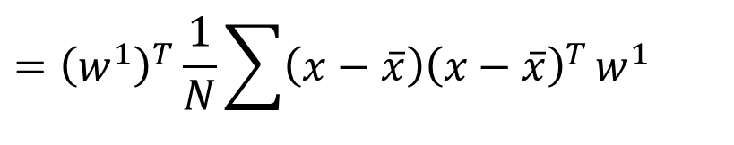
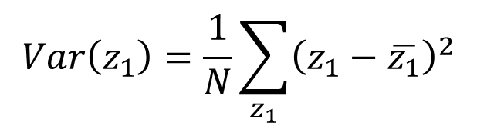
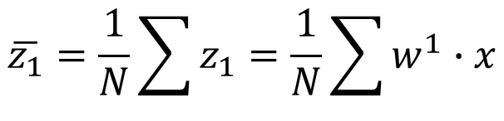
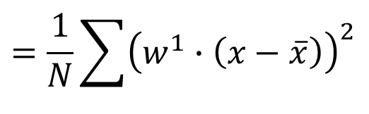
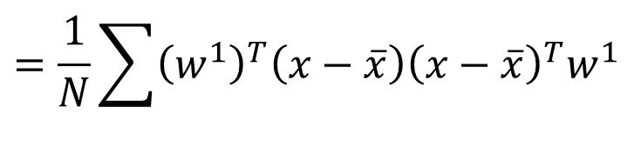



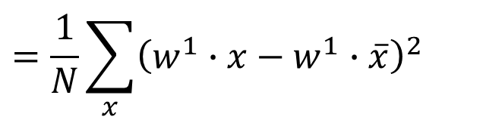








PCA
$$z_{1}=w^{1}∙x$$
$$\overline{z_{1}}=\frac{1}{N}\sum{z_{1}}=\frac{1}{N}\sum{w^{1}∙x}$$
$$=w^{1}∙\frac{1}{N}\sum{x}$$
$$=w^{1}∙\overline{x}$$
$$Var\left(z_{1}\right)=\frac{1}{N}\sum_{z_{1}}{{\left(z_{1}−\overline{z_{1}}\right)}^{2}}$$
$${\left(a∙b\right)}^{2}={\left(a^{T}b\right)}^{2}$$
$$=a^{T}ba^{T}b$$
$$=\frac{1}{N}\sum_{x}{{\left(w^{1}∙x−w^{1}∙\overline{x}\right)}^{2}}$$
$$=a^{T}b{\left(a^{T}b\right)}^{T}$$
$$=a^{T}bb^{T}a$$
$$=\frac{1}{N}\sum{{\left(w^{1}∙\left(x−\overline{x}\right)\right)}^{2}}$$
Find $w^{1}$ maximizing
$$=\frac{1}{N}\sum{{\left(w^{1}\right)}^{T}\left(x−\overline{x}\right){\left(x−\overline{x}\right)}^{T}w^{1}}$$
$${\left(w^{1}\right)}^{T}Sw^{1}$$
$$={\left(w^{1}\right)}^{T}\frac{1}{N}\sum{\left(x−\overline{x}\right){\left(x−\overline{x}\right)}^{T}}w^{1}$$
$${\left\|w^{1}\right\|}_{2}={\left(w^{1}\right)}^{T}w^{1}=1$$
$$={\left(w^{1}\right)}^{T}Cov\left(x\right)w^{1}$$
$$S=Cov\left(x\right)$$

Slide 10
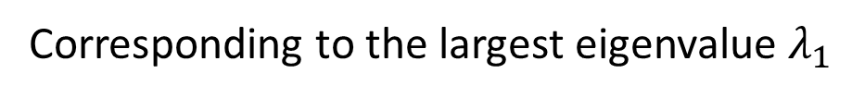


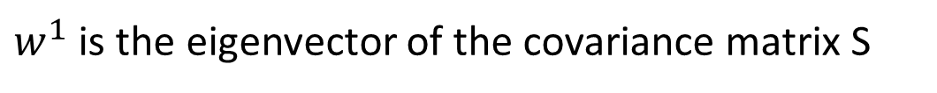

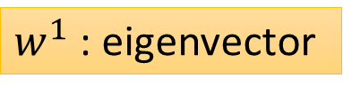

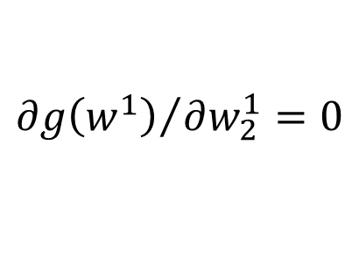


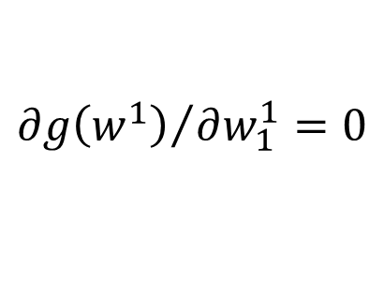


Find $w^{1}$ maximizing
$${\left(w^{1}\right)}^{T}Sw^{1}$$
$${\left(w^{1}\right)}^{T}w^{1}=1$$
$$S=Cov\left(x\right)$$
Symmetric
Positive-semidefinite
(non-negative eigenvalues)
Using Lagrange multiplier [Bishop, Appendix E]
$g\left(w^{1}\right)=$ ${\left(w^{1}\right)}^{T}Sw^{1}−α\left({\left(w^{1}\right)}^{T}w^{1}−1\right)$
$${∂g\left(w^{1}\right)}/{∂w_{1}^{1}=0}$$
$$Sw^{1}−αw^{1}=0$$
$$Sw^{1}=αw^{1}$$
$w^{1}$ : eigenvector
$${∂g\left(w^{1}\right)}/{∂w_{2}^{1}=0}$$
…
$${\left(w^{1}\right)}^{T}Sw^{1}=α{\left(w^{1}\right)}^{T}w^{1}$$
$$=α$$
Choose the maximum one
$w^{1}$ is the eigenvector of the covariance matrix S
Corresponding to the largest eigenvalue $λ_{1}$
Notes:
• The eigenvalues for symmetric matrices are always real.
a symmetric {\displaystyle n} × {\displaystyle n} real matrix {\displaystyle M} is said to be positive definite if the scalar {\displaystyle z^{\mathrm {T} }Mz} is positive for every non-zero column vector {\displaystyle z} of {\displaystyle n} real numbers
zTMz>=0
Ref: http://speech.ee.ntu.edu.tw/~tlkagk/courses/LA_2016/Lecture/special%20matrix%20(v2).ecm.mp4/index.html

Slide 11
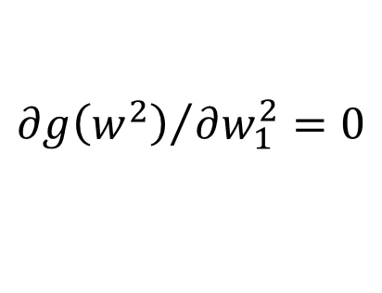



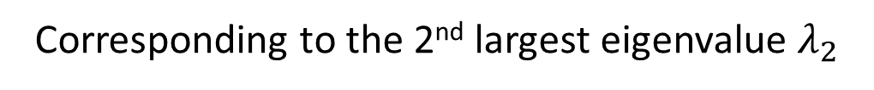


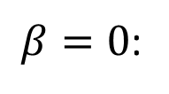


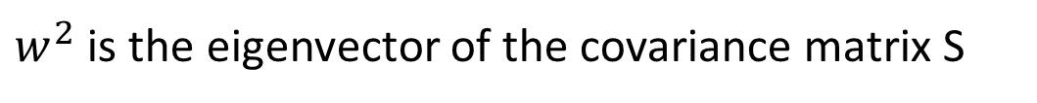





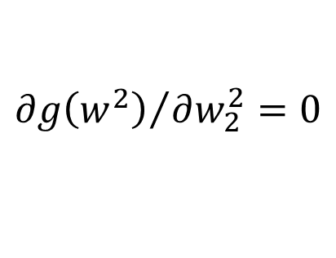


Find $w^{2}$ maximizing
$${\left(w^{2}\right)}^{T}Sw^{2}$$
$${\left(w^{2}\right)}^{T}w^{2}=1$$
$${\left(w^{2}\right)}^{T}w^{1}=0$$
$g\left(w^{2}\right)=$ ${\left(w^{2}\right)}^{T}Sw^{2}−α\left({\left(w^{2}\right)}^{T}w^{2}−1\right)$
$$−β\left({\left(w^{2}\right)}^{T}w^{1}−0\right)$$
$${∂g\left(w^{2}\right)}/{∂w_{1}^{2}=0}$$
$$Sw^{2}−αw^{2}−βw^{1}=0$$
0
0
1
$${\left(w^{1}\right)}^{T}Sw^{2}−α{\left(w^{1}\right)}^{T}w^{2}−β{\left(w^{1}\right)}^{T}w^{1}=0$$
$${∂g\left(w^{2}\right)}/{∂w_{2}^{2}=0}$$
$$={\left({\left(w^{1}\right)}^{T}Sw^{2}\right)}^{T}$$
$$={\left(w^{2}\right)}^{T}S^{T}w^{1}$$
…
$$={\left(w^{2}\right)}^{T}Sw^{1}$$
$$=λ_{1}{\left(w^{2}\right)}^{T}w^{1}$$
$$=0$$
$$Sw^{1}=λ_{1}w^{1}$$
$β=0$:
$$Sw^{2}−αw^{2}=0$$
$$Sw^{2}=αw^{2}$$
$w^{2}$ is the eigenvector of the covariance matrix S
Corresponding to the 2nd largest eigenvalue $λ_{2}$

Slide 12
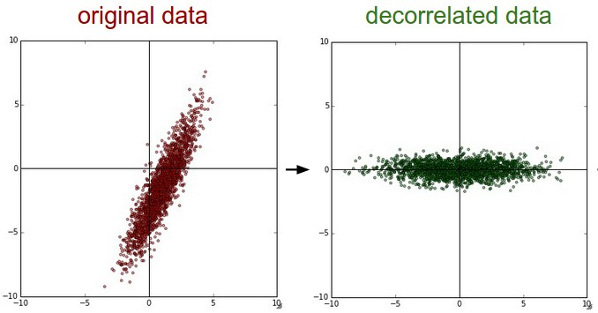












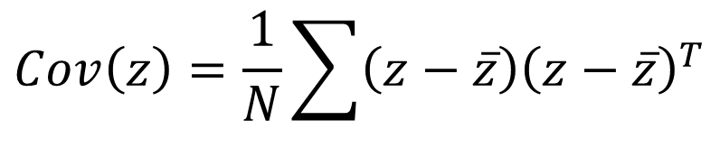


PCA - decorrelation
$$x_{2}$$
$$z_{2}$$
$$z=Wx$$
$$x_{1}$$
$$z_{1}$$
$$Cov\left(z\right)=D$$
PCA
Diagonal matrix
$$Cov\left(z\right)=\frac{1}{N}\sum{\left(z−\overline{z}\right){\left(z−\overline{z}\right)}^{T}}$$
$$=WSW^{T}$$
$$S=Cov\left(x\right)$$
$$=WS\left[\begin{matrix}w^{1} & ⋯ & w^{K}\end{matrix}\right]$$
$$=W\left[S\begin{matrix}w^{1} & ⋯ & Sw^{K}\end{matrix}\right]$$
$$=W\left[λ_{1}\begin{matrix}w^{1} & ⋯ & λ_{K}w^{K}\end{matrix}\right]$$
$$=\left[λ_{1}\begin{matrix}{Ww}^{1} & ⋯ & λ_{K}{Ww}^{K}\end{matrix}\right]$$
$$=\left[λ_{1}\begin{matrix}e_{1} & ⋯ & λ_{K}e_{K}\end{matrix}\right]$$
$$=D$$
Diagonal matrix

Slide 13
End of Warning
Notes:
So many good explaination !!!!!!!!!!!!!!!!!
http://stats.stackexchange.com/questions/2691/making-sense-of-principal-component-analysis-eigenvectors-eigenvalues

Slide 14

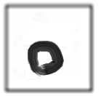

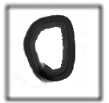




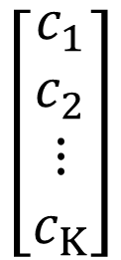
PCA – Another Point of View
Basic Component:
1
0
1
0
1
…….
u¹
u²
u³
u⁴
u⁵
$$\left[\begin{aligned}1 \\ 0 \\ 1 \\ 0 \\ 1 \\ ⋮\end{aligned}\right]$$
1x
1x
1x
$$≈$$
+
+
u¹
u³
u⁵
$$\left[\begin{aligned}c_{1} \\ c_{2} \\ ⋮ \\ c_{K}\end{aligned}\right]$$
$$x≈c_{1}u^{1}+c_{2}u^{2}+⋯+c_{K}u^{K}+\overline{x}$$
Represent a digit image
Pixels in a digit image
component
Notes:
https://pvirie.wordpress.com/2016/03/29/linear-autoencoders-do-pca/
https://pvirie.wordpress.com/2013/10/01/pattern-covariance-analysis-of-components/

Slide 15

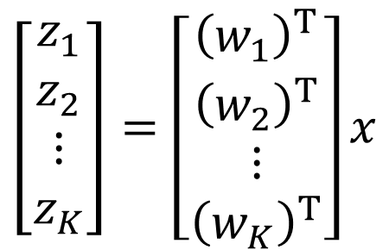

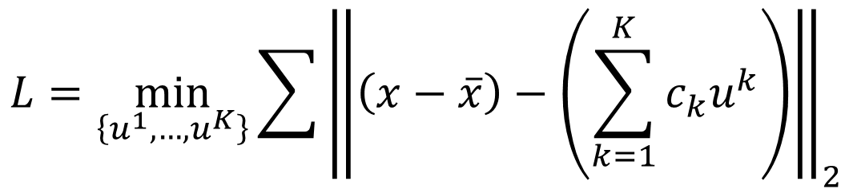

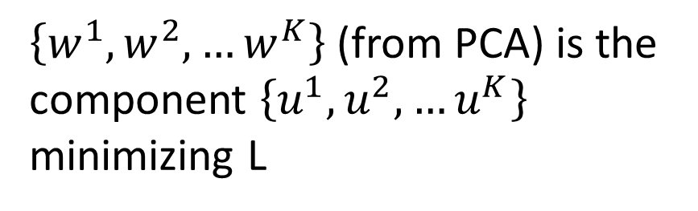


PCA – Another Point of View
$$x−\overline{x}≈c_{1}u^{1}+c_{2}u^{2}+⋯+c_{K}u^{K}$$
$$=\hat{x}$$
Reconstruction error:
$${\left\| (x−\overline{x})−\hat{x}\right\|}_{2}$$
Find $\left\{u^{1},…,u^{K}\right\}$ minimizing the error
$$L=\min_{\left\{u^{1},…,u^{K}\right\}}{\sum{{\left\|\left(x−\overline{x}\right)−\left(\sum_{k=1}^{K}{c_{k}u^{k}}\right)\right\|}_{2}}}$$
PCA:
$$z=Wx$$
$$\hat{x}$$
$$\left[\begin{aligned}z_{1} \\ z_{2} \\ ⋮ \\ z_{K}\end{aligned}\right]=\left[\begin{aligned}{\left(w_{1}\right)}^{T} \\ {\left(w_{2}\right)}^{T} \\ ⋮ \\ {\left(w_{K}\right)}^{T}\end{aligned}\right]x$$
$\left\{w^{1},w^{2},…w^{K}\right\}$ (from PCA) is the component $\left\{u^{1},u^{2},…u^{K}\right\}$ minimizing L
Proof in [Bishop, Chapter 12.1.2]

Slide 16













$$x−\overline{x}≈c_{1}u^{1}+c_{2}u^{2}+⋯+c_{K}u^{K}$$
$$=\hat{x}$$
Reconstruction error:
$${\left\| (x−\overline{x})−\hat{x}\right\|}_{2}$$
Find $\left\{u^{1},…,u^{K}\right\}$ minimizing the error
$$x^{1}−\overline{x}≈c_{1}^{1}u^{1}+c_{2}^{1}u^{2}+⋯$$
$$x^{2}−\overline{x}≈c_{1}^{2}u^{1}+c_{2}^{2}u^{2}+⋯$$
$$x^{3}−\overline{x}≈c_{1}^{3}u^{1}+c_{2}^{3}u^{2}+⋯$$
……
u¹
u²
$$c_{1}^{1}$$
$$c_{1}^{2}$$
$$c_{1}^{3}$$
…
$$≈$$
$$c_{2}^{2}$$
…
$$c_{2}^{1}$$
$$c_{2}^{3}$$
Minimize Error
…
…
…
Matrix X
Notes:
Link PCA with MDS
[1] T. Cox and M. Cox. Multidimensional Scaling. Chapman Hall, Boca Raton, 2nd edition, 2001.

Slide 17









$$x^{1}−\overline{x}$$
u¹
u²
$$c_{1}^{1}$$
$$c_{1}^{2}$$
$$c_{1}^{3}$$
…
$$≈$$
…
$$c_{2}^{1}$$
$$c_{2}^{2}$$
$$c_{2}^{3}$$
Minimize Error
…
…
…
Matrix X
M x N
M x K
K x K
K x N
X
U
∑
V
$$≈$$
K columns of U: a set of orthonormal eigen vectors corresponding to the K largest eigenvalues of XX^{T}
This is the solution of PCA
SVD:
http://speech.ee.ntu.edu.tw/~tlkagk/courses/LA_2016/Lecture/SVD.pdf

Slide 18



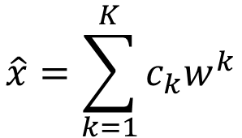

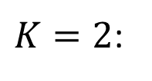



PCA looks like a neural network with one hidden layer (linear activation function)
Autoencoder
If $\left\{w^{1},w^{2},…w^{K}\right\}$ is the component $\left\{u^{1},u^{2},…u^{K}\right\}$
$$\hat{x}=\sum_{k=1}^{K}{c_{k}w^{k}}$$
To minimize reconstruction error:
$$x−\overline{x}$$
$$c_{k}=\left(x−\overline{x}\right)∙w^{k}$$
$K=2$:
$$w_{1}^{1}$$
$$c_{1}$$
$$x−\overline{x}$$
$$w_{2}^{1}$$
$$w_{3}^{1}$$
Notes:
$$K=2$$

Slide 19





PCA looks like a neural network with one hidden layer (linear activation function)
Autoencoder
If $\left\{w^{1},w^{2},…w^{K}\right\}$ is the component $\left\{u^{1},u^{2},…u^{K}\right\}$
$$\hat{x}=\sum_{k=1}^{K}{c_{k}w^{k}}$$
To minimize reconstruction error:
$$x−\overline{x}$$
$$c_{k}=\left(x−\overline{x}\right)∙w^{k}$$
$K=2$:
$$c_{1}$$
$$x−\overline{x}$$
$$w_{1}^{2}$$
$$c_{2}$$
$$w_{2}^{2}$$
$$w_{3}^{2}$$
Notes:
$$K=2$$

Slide 20






PCA looks like a neural network with one hidden layer (linear activation function)
Autoencoder
If $\left\{w^{1},w^{2},…w^{K}\right\}$ is the component $\left\{u^{1},u^{2},…u^{K}\right\}$
$$\hat{x}=\sum_{k=1}^{K}{c_{k}w^{k}}$$
To minimize reconstruction error:
$$x−\overline{x}$$
$$c_{k}=\left(x−\overline{x}\right)∙w^{k}$$
$K=2$:
$$w_{1}^{1}$$
$${\hat{x}}_{1}$$
$$c_{1}$$
$$w_{2}^{1}$$
$$x−\overline{x}$$
$$w_{1}^{2}$$
$${\hat{x}}_{2}$$
$$c_{2}$$
$$w_{3}^{1}$$
$$w_{2}^{2}$$
$$w_{3}^{2}$$
$${\hat{x}}_{3}$$
Notes:
$$K=2$$

Slide 21




PCA looks like a neural network with one hidden layer (linear activation function)
Autoencoder
If $\left\{w^{1},w^{2},…w^{K}\right\}$ is the component $\left\{u^{1},u^{2},…u^{K}\right\}$
$$\hat{x}=\sum_{k=1}^{K}{c_{k}w^{k}}$$
To minimize reconstruction error:
$$x−\overline{x}$$
$$c_{k}=\left(x−\overline{x}\right)∙w^{k}$$
$K=2$:
It can be deep.
Deep Autoencoder
$${\hat{x}}_{1}$$
$$c_{1}$$
Minimize error
$$w_{1}^{2}$$
$$x−\overline{x}$$
$${\hat{x}}_{2}$$
$$x−\overline{x}$$
$$w_{1}^{2}$$
$$c_{2}$$
$$w_{2}^{2}$$
$$w_{2}^{2}$$
Gradient Descent?
$$w_{3}^{2}$$
$${\hat{x}}_{3}$$
$$w_{3}^{2}$$
Notes:
$$K=2$$

Slide 22
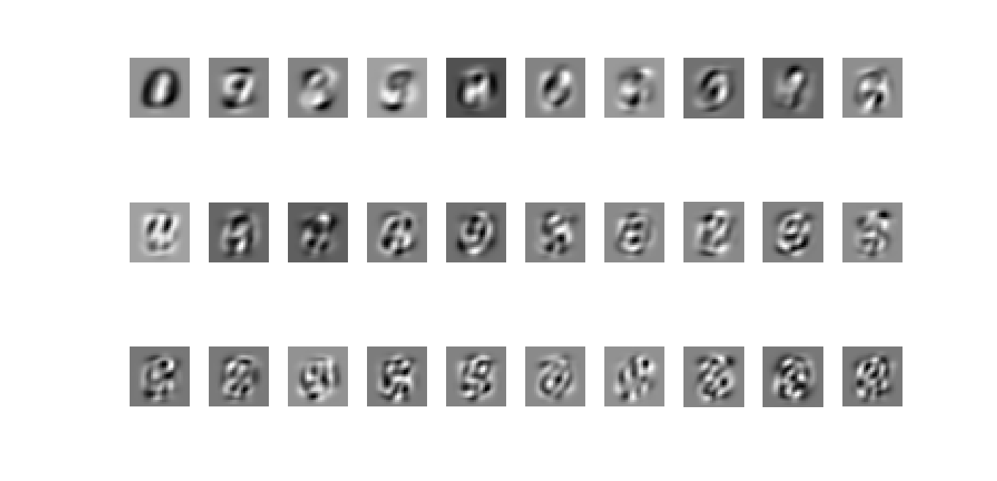

PCA - MNIST
$$=a_{1}w^{1}+a_{2}w^{2}+⋯$$
images
30 components:
Eigen-digits

Slide 23
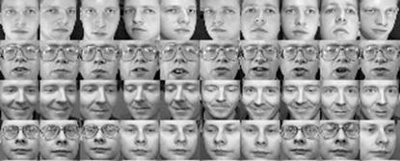
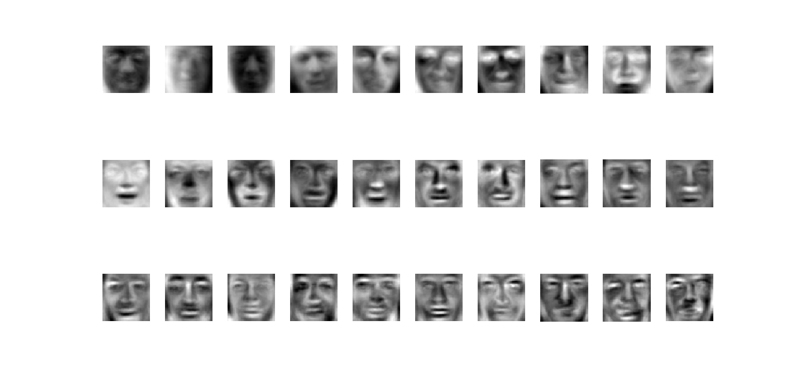
PCA - Face
30 components:
http://www.cs.unc.edu/~lazebnik/research/spring08/assignment3.html
Eigen-face
Notes:
Example of an original image of ORL face database

Slide 24
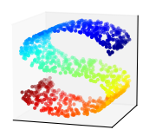
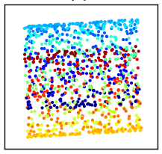
Weakness of PCA
Unsupervised
Linear
PCA
LDA
http://www.astroml.org/book_figures/chapter7/fig_S_manifold_PCA.html

Slide 25
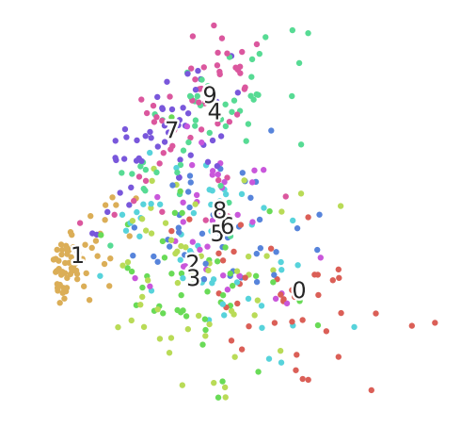
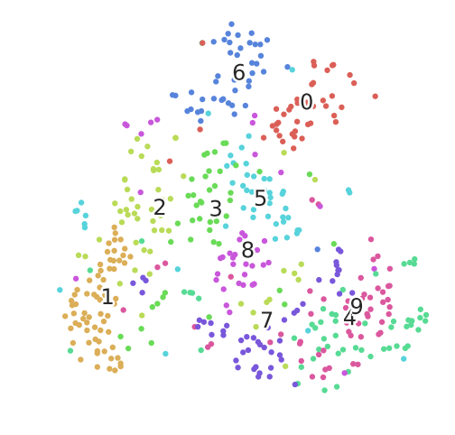
Weakness of PCA
Pixel (28x28) -> PCA (2)
Pixel (28x28) -> tSNE (2)

Slide 26
Auto-encoder

Slide 27
Auto-encoder
Usually <784
Compact representation of the input object
NN
Encoder
code
28 X 28 = 784
Learn together
NN
Decoder
Can reconstruct the original object
code

Slide 28







Recap: PCA
Minimize
$${\left(x−\hat{x} \right)}^{2}$$
As close as possible
encode
decode
$$x$$
$$c$$
$$\hat{x}$$
$$W$$
$$W^{T}$$
hidden layer
(linear)
Input layer
output layer
Bottleneck layer
Output of the hidden layer is the code
Notes:
A neutral net whose output tries to reconstruct the input
Target of output ($\hat{y}$) = input ($x$)

Slide 29






Deep Auto-encoder
Symmetric is not necessary.
Of course, the auto-encoder can be deep
As close as possible
…
…
Layer
Layer
Output Layer
Input Layer
Layer
bottle
Layer
Layer
Layer
$$W_{2}^{T}$$
$$W_{1}$$
$$W_{2}$$
$$W_{1}^{T}$$
Initialize by RBM layer-by-layer
$$x$$
Code
$$\hat{x}$$
Reference: Hinton, Geoffrey E., and Ruslan R. Salakhutdinov. "Reducing the dimensionality of data with neural networks." Science 313.5786 (2006): 504-507
Notes:
codes

Slide 30




Deep Auto-encoder
Original Image
784
30
784
PCA
Deep
Auto-encoder
784
1000
500
250
30
250
500
784
1000
Notes:
Hand-written digits
Deep auto-encoder has better reconstruction capability

Slide 31
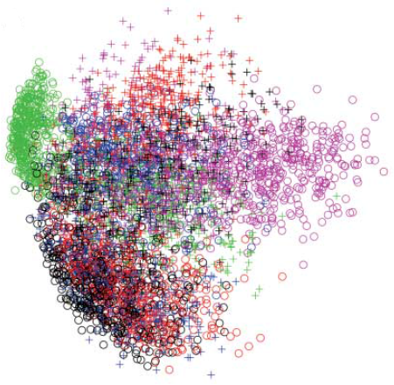
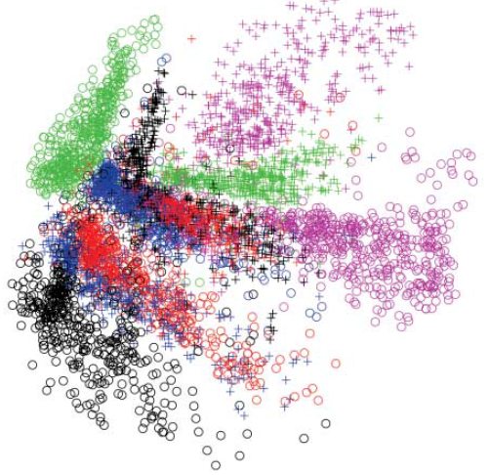
784
2
784
784
1000
500
250
2
250
500
784
1000
Notes:
From 30 to 2

Slide 32
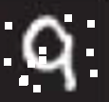




Auto-encoder
More: Contractive auto-encoder
Ref: Rifai, Salah, et al. "Contractive auto-encoders: Explicit invariance during feature extraction.“ Proceedings of the 28th International Conference on Machine Learning (ICML-11). 2011.
De-noising auto-encoder
As close as possible
encode
decode
$$c$$
$$x$$
$$x′$$
$$\hat{x}$$
Add noise
Vincent, Pascal, et al. "Extracting and composing robust features with denoising autoencoders." ICML, 2008.
Notes:
有收縮性的

Slide 33
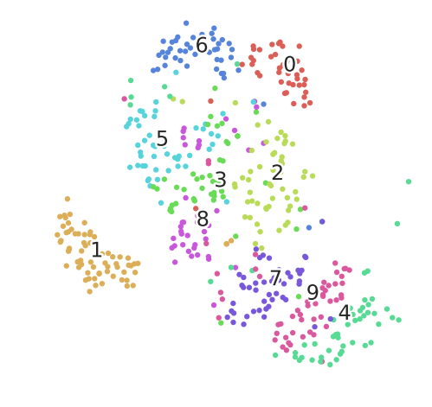
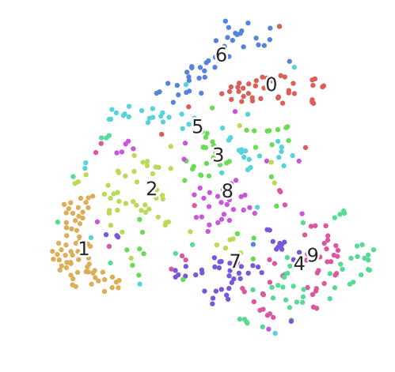

Deep Auto-encoder - Example
NN
Encoder
$$c$$
PCA reduces to 32-dim
Pixel -> tSNE

Slide 34
Auto-encoder – Text Retrieval
Vector Space Model
Bag-of-word
this
1
is
1
word string:
“This is an apple”
query
a
0
an
1
…
apple
1
pen
0
document
Semantics are not considered.
Notes:
idf

Slide 35


Auto-encoder – Text Retrieval
The documents talking about the same thing will have close code.
2
query
125
250
500
2000
LSA: project documents to 2 latent topics
Bag-of-word
(document or query)
Notes:
The qeruy not always have the common word

Slide 36


Auto-encoder – Similar Image Search
Retrieved using Euclidean distance in pixel intensity space
(Images from Hinton’s slides on Coursera)
Reference: Krizhevsky, Alex, and Geoffrey E. Hinton. "Using very deep autoencoders for content-based image retrieval." ESANN. 2011.
Notes:
Direct compute on pixel label is slow!

Slide 37




Auto-encoder – Similar Image Search
code
8192
2048
1024
512
256
4096
32x32
(crawl millions of images from the Internet)
Notes:
Reconstructions of 32x32 color images from 256-bit codes

Slide 38


Retrieved using Euclidean distance in pixel intensity space
retrieved using 256 codes
Notes:
faster

Slide 39

Auto-encoder for CNN
As close as possible
Deconvolution
Unpooling
Convolution
Deconvolution
Pooling
Unpooling
Convolution
code
Deconvolution
Pooling
Notes:
這個圖可能有問題!

Slide 40


CNN -Unpooling
14 x 14
28 x 28
Alternative: simply repeat the values
Source of image : https://leonardoaraujosantos.gitbooks.io/artificial-inteligence/content/image_segmentation.html

Slide 41
CNN - Deconvolution
Actually, deconvolution is convolution.
+
+
+
=
+

Slide 42


Auto-encoder – Pre-training DNN
Greedy Layer-wise Pre-training again
output
10
500
Target
1000
784
$$\hat{x}$$
W¹’
1000
1000
W¹
Input
784
Input
784
$$x$$

Slide 43



Auto-encoder – Pre-training DNN
Greedy Layer-wise Pre-training again
output
10
500
1000
$${\hat{a}}^{1}$$
W²’
Target
1000
1000
W²
1000
1000
$$a^{1}$$
fix
W¹
Input
784
Input
784
$$x$$

Slide 44


Auto-encoder – Pre-training DNN
Greedy Layer-wise Pre-training again
output
$${\hat{a}}^{2}$$
10
1000
W³’
500
500
W³
Target
$$a^{2}$$
1000
1000
fix
W²
1000
1000
$$a^{1}$$
fix
W¹
Input
784
Input
784
$$x$$

Slide 45
Auto-encoder – Pre-training DNN
Find-tune by backpropagation
Greedy Layer-wise Pre-training again
output
output
10
10
Random init
W⁴
500
500
W³
Target
1000
1000
W²
1000
1000
W¹
Input
784
Input
784
$$x$$

